Slide 1
Classifier Accuracy Measures
Evaluating Classification Algorithms
Utkarsh Sharma
Asst. Prof. CSE Dept.
Jaypee University Of Engineering & Technology
India

Slide 2
Contents
Why Do we need Evaluation
Metrics for evaluation
Confusion Matrix

Slide 3
Why Evaluation..???
How to evaluate the performance of a model?
How to obtain reliable estimates?
How to compare the relative performance among competing models?
Given two equally performing models,
which one should we prefer?

Slide 4
Need
Evaluating the quality of our machine learning model is extremely important for continuing to improve our model until it performs as best as it can.
For classification problems, evaluation metrics compare the expected class label to the predicted class label or interpret the predicted probabilities for the class labels.
For example, suppose you used data from previous sales to train a classifier to predict customer purchasing behavior. You would like an estimate of how accurately the classifier can predict the purchasing behavior of future customers, that is, future customer data on which the classifier has not been trained.

Slide 5
Metrics for Performance Evaluation
1. Confusion Matrix
2. Precision
3. Recall
4. Accuracy
5. Specificity
6. F1-Score

Slide 6
Confusion Matrix
The confusion matrix is a useful tool for analyzing how well your classifier can recognize tuples of different classes.
A confusion matrix is a table with four different combinations of predicted and actual values.
Given m classes, a confusion matrix is a table of at least size m by m. An entry, CMi, j in the first m rows and m columns indicates the number of tuples of class i that were labeled by the classifier as class j.
For a classifier to have good accuracy, ideally most of the tuples would be represented along the diagonal of the confusion matrix, from entry CM1, 1 to entry CMm, m, with the rest of the entries being close to zero.

Slide 7
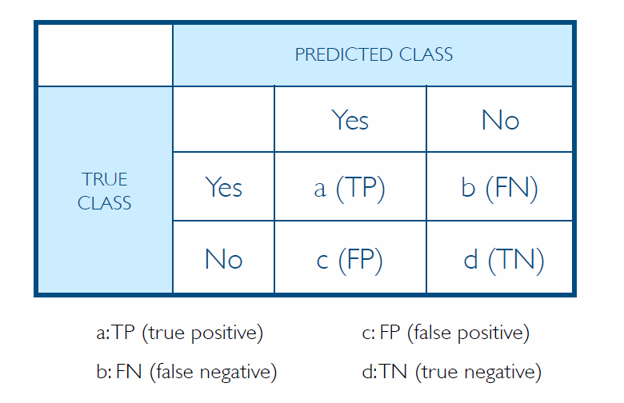
Confusion Matrix Example(Binary Classification)
True Positives (TP) : The number of times our model predicted YES and the actual output was also YES.
True Negatives (TN): The number of times our model predicted NO and the actual output was NO.
False Positives (FP): The number of times our model predicted YES and the actual output was NO. This is known as a Type 1 Error.
False Negatives (FN): The number of times our model predicted NO and the actual output was YES. This is known as a Type 2 Error.

Slide 8
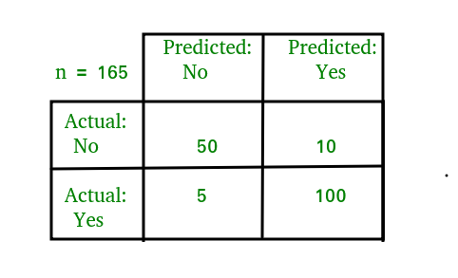
Example to Read confusion matrix:
TP = 100
TN = 50
FP = 10
FN = 5

Slide 9
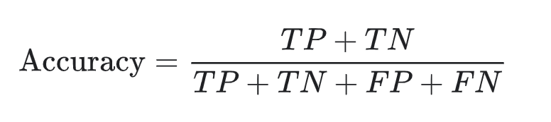
Accuracy
Accuracy is determining out of all the classifications, how many did we classify correctly? This can be represented mathematically as:
Using our confusion matrix terms, this equation is written as:
We want the accuracy score to be as high as possible. It is important to note that accuracy may not always be the best metric to use, especially in cases of a class-imbalanced data set. This is when the distribution of data is not equal across all classes.

Slide 10
Sometimes Accuracy is not Enough
Consider a 2-class problem
Number of Class 0 examples = 9990
Number of Class 1 examples = 10
If model predicts everything to be class 0,
accuracy is 9990/10000 = 99.9 %
Accuracy is misleading because model does not detect any class 1 example

Slide 11

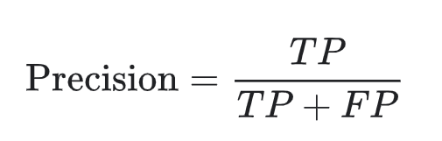
Precision
Precision can be described as the fraction of relevant instances among the retrieved instances. This answers the question “ What proportion of positive identifications was actually correct?” The formula is as follows:
In the terms of our confusion matrix, the equation can be represented as:
Precision expresses the proportion of the data points our model says was relevant actually were relevant.

Slide 12

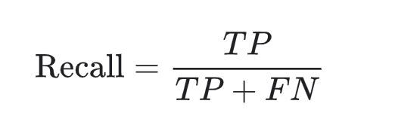
Recall
Recall, also known as sensitivity. This answers the question “What proportion of actual positives was classified correctly?” This can be represented by the following equation:
In our confusion matrix, it would be represented by:
Recall expresses which instances are relevant in a data set. It is important to examine both the Precision AND Recall when evaluating a model because they often have an inverse relationship. When precision increases, recall tends to decrease and vice versa.

Slide 13
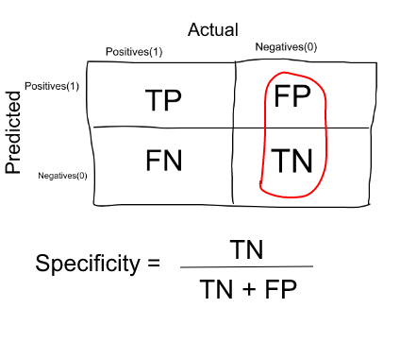
Specificity
Specificity (SP) is calculated as the number of correct negative predictions divided by the total number of negatives. It is also called true negative rate (TNR). The best specificity is 1.0, whereas the worst is 0.0.
Specificity is the exact opposite of Recall.

Slide 14

F1-Score
The F1 Score is a function of precision and recall. It is used to find the correct balance between the two metrics. It determines how many instances your model classifies correctly without missing a significant number of instances. This score can be represented by the following equation:
Having an imbalance between precision and recall, such as a high precision and low recall, can give you an extremely accurate model, but classifies difficult data incorrectly. We want the F1 Score to be as high as possible for the best performance of our model.

Slide 15
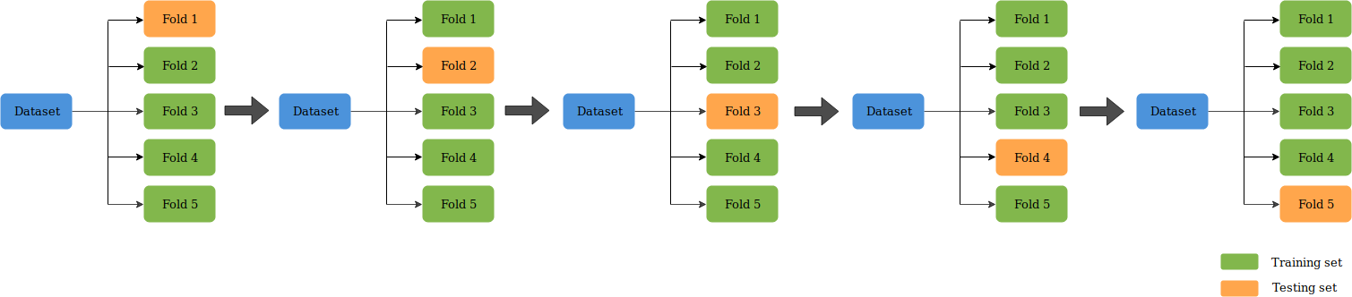
K-Fold Cross Validation
K-Fold CV is where a given data set is split into a K number of sections/folds where each fold is used as a testing set at some point.
Lets take the scenario of 5-Fold cross validation(K=5). Here, the data set is split into 5 folds. In the first iteration, the first fold is used to test the model and the rest are used to train the model. In the second iteration, 2nd fold is used as the testing set while the rest serve as the training set. This process is repeated until each fold of the 5 folds have been used as the testing set.

Slide 16
Example
 |  | Predicted
 |  | A | B | C
Actual | A | 15 | 2 | 3
 | B | 7 | 15 | 8
 | C | 2 | 3 | 45
Calculate Accuracy, Precision and Recall for this model.

Slide 17

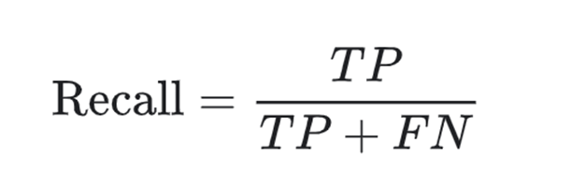


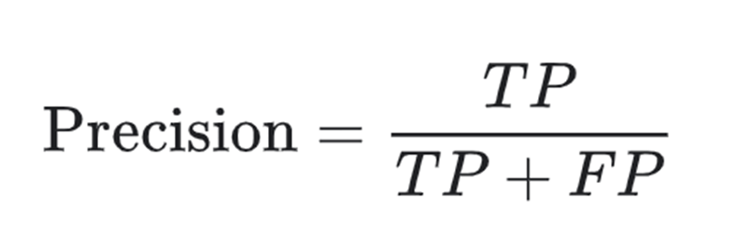
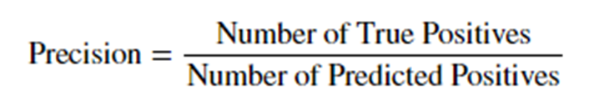

Slide 18
Accuracy
Number of TP
 |  | Predicted
 |  | A | B | C
Actual | A | 15 | 2 | 3
 | B | 7 | 15 | 8
 | C | 2 | 3 | 45
 |  | Predicted
 |  | A | B | C
Actual | A | 15 | 2 | 3
 | B | 7 | 15 | 8
 | C | 2 | 3 | 45
Correctly identified prediction for each class
Accuracy= (15+15+45)/100

Slide 19
Precision
 |  | Predicted
 |  | A | B | C
Actual | A | 15 | 2 | 3
 | B | 7 | 15 | 8
 | C | 2 | 3 | 45
Precision B =
15
/(3+8+45)
Precision A =
15
/(15+7+2)
15
/(2+15+3)
Precision C =

Slide 20
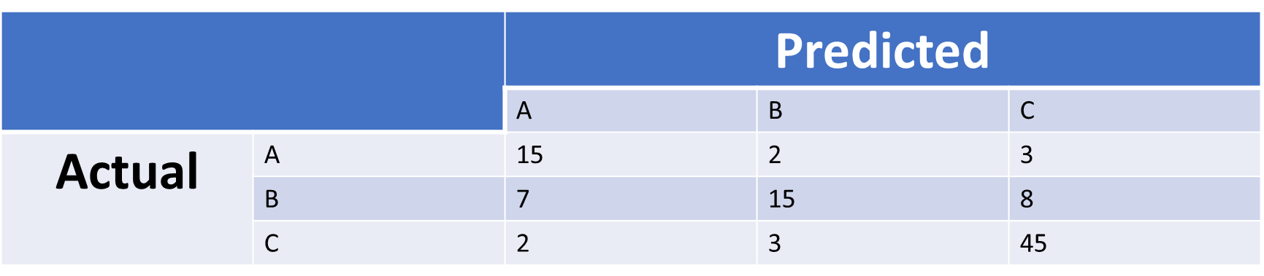
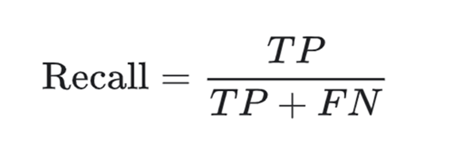
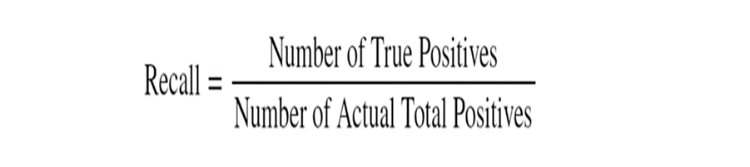
Recall
Recall A =
15
/(15+2+3)
Recall B =
15
/(7+15+8)
Recall C =
45
/(2+3+45)

Slide 21
References
https://www.geeksforgeeks.org/confusion-matrix-machine-learning/
https://medium.com/thalus-ai/performance-metrics-for-classification-problems-in-machine-learning-part-i-b085d432082b
https://towardsdatascience.com/evaluation-metrics-for-classification-problems-in-machine-learning-d9f9c7313190
Han, Jiawei, and Micheline Kamber. Data Mining: Concepts and Techniques. San Francisco: Morgan Kaufmann Publishers, 2001.
https://www.slideshare.net/pierluca.lanzi/dmtm-lecture-06-classification-evaluation

